Slide 1
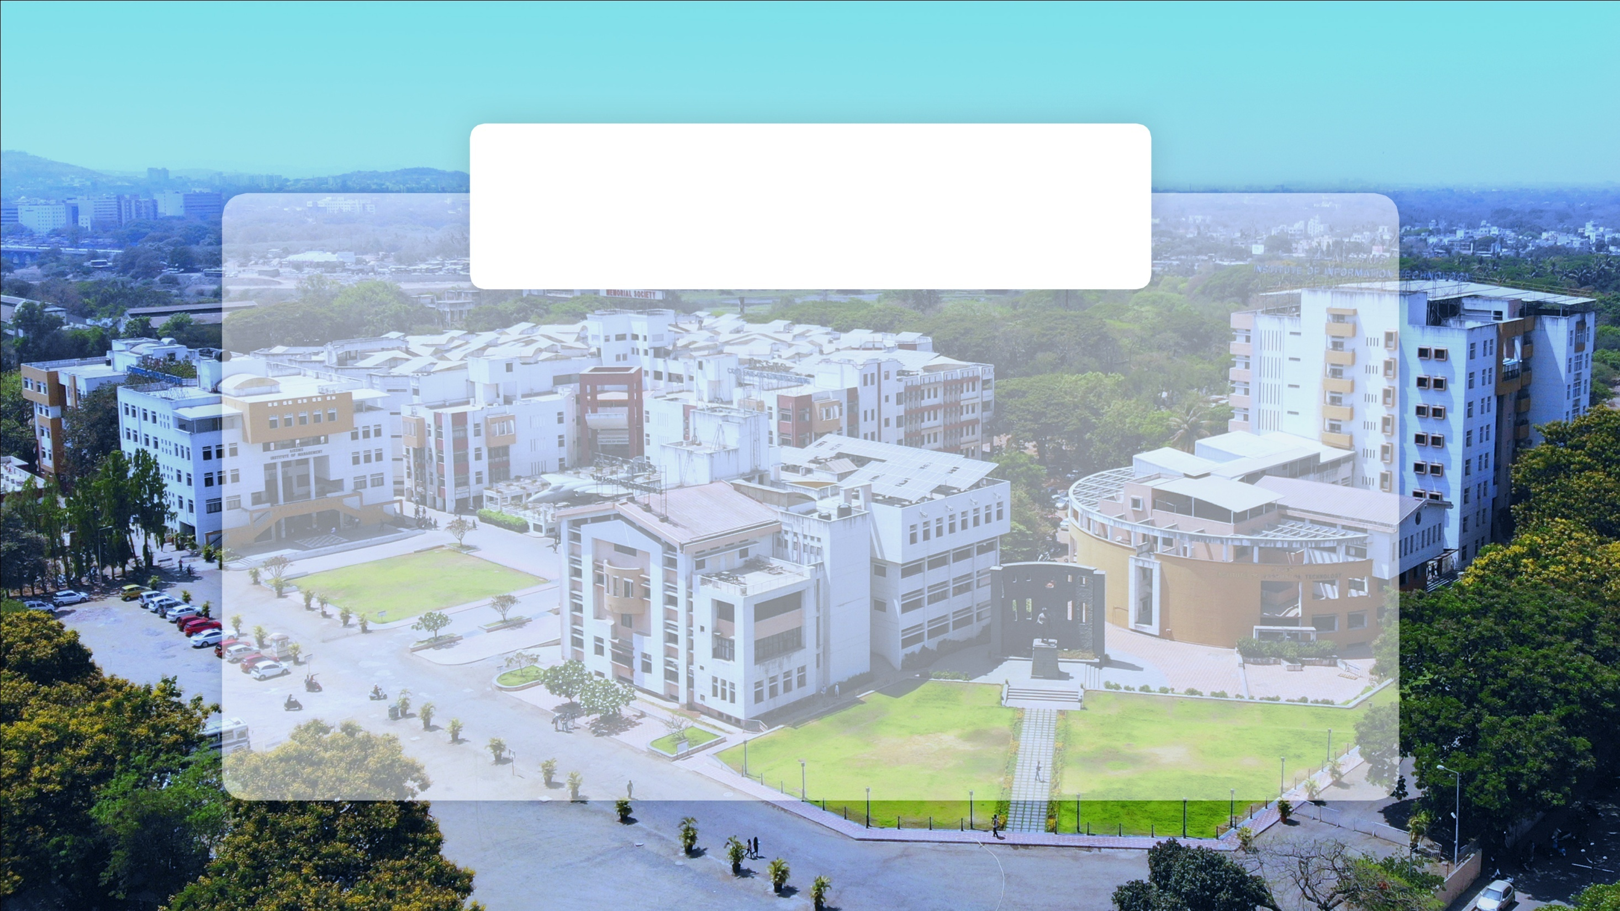

Subject: Internship Presentation Introduction & Model Presentation
Samruddhi Mahesh Navaghane
Artificial Intelligence and Data Science Department
AISSMS IOIT, Pune

Slide 2
INTERNSHIP PROJECT SHOWCASE
Project Title:
DATA SCIENCE
| Abstract |Introduction | Problem Statement | Methodology |Model application | Conclusion |

Slide 3
ABSTRACT
During my 3-month on-site internship at Tata Motors, I focused on applying data analytics and machine learning (ML) techniques to derive valuable automotive insights. The primary goal of the internship was to develop predictive models that could optimize vehicle performance by analyzing electric power consumption, drag forces, and other key metrics.The project began with an introduction to objectives, which included leveraging AI techniques to process real-world vehicle data, overcoming challenges in data preprocessing, and ensuring accurate predictions through model selection and fine-tuning. By addressing these challenges, we aimed to deliver data-driven solutions to improve vehicle performance and enhance decision-making processes within the automotive industry.
Throughout the internship, I collaborated with domain experts and fellow team members, which helped foster growth in technical skills, particularly in data science, machine learning, and predictive modeling. Feedback from peers and mentors allowed for continuous improvement, culminating in actionable insights that were successfully applied to real-world vehicle data.This internship experience provided a strong foundation in applying AI and ML techniques to automotive data analytics, contributing to future professional development in the field.

Slide 4
INTRODUCTION
This project, titled "Data Science Project on Energy Data," focuses on predicting electrical energy consumption based on the number of equivalent vehicles. By leveraging machine learning models, the project aims to analyze and optimize energy consumption patterns, providing actionable insights for efficient energy management in electric and hybrid vehicles. The study is motivated by the growing need to reduce energy wastage and operational costs through accurate prediction models. Using techniques such as Linear Regression, Clustering (HDBSCAN, GMM), and Time-Series Forecasting (Exponential Smoothing, ARIMAX, LSTM), the project evaluated model performance and highlighted the importance of dynamic adjustments in energy forecasting. These findings can significantly contribute to optimizing energy usage and supporting informed decision-making in the automotive industry.

Slide 5
PROBLEM STATEMENT
This project focuses on predicting electrical energy consumption based on the number of equivalent vehicles and analyzing its accuracy using data-driven models. The aim is to uncover the correlation between energy consumption patterns and key vehicle parameters, providing valuable insights for optimization in energy management.

Slide 6
METHODOLOGY
In this project, multiple predictive models including Linear Regression,Clustering (HDBSCAN, GMM), Time-series Forecasting(Exponential Smoothening, ARIMAX, LSTM) were used to forecast electrical energy consumption based on vehicle usage data. Data was cleaned, scaled, and split into training and testing sets.Models were evaluated based on performance metrics MSE,RMSE,Accuracy.

Slide 7
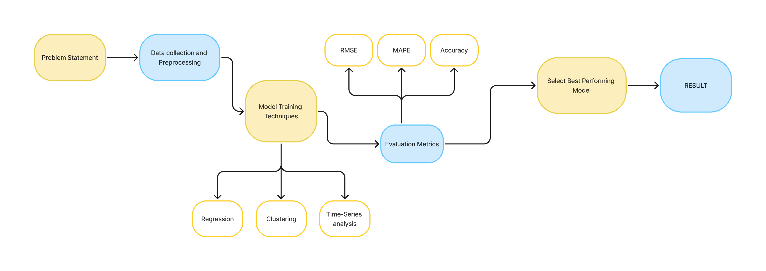
METHODOLOGY(1)

Slide 8
CONCLUSION
The analysis concludes that while linear regression and clustering methods were insufficient, the Bidirectional-LSTM model provided the best fit for forecasting power consumption with an accuracy of 88.45%, This comprehensive approach highlights the importance of selecting appropriate models based on data characteristics and relationships.

Slide 9

THANKYOU!

